Slide 1

H.M. Sahan Sachintha
PROJECT PRESENTATION
KUR/IT/F/2021/0009

Slide 2
Content
Introduction
Objective
Technology Used
Project Sample
How to develop
Gantt Chart
Software & Hardware
End

Slide 3
Introduction
Smart Dustbin
This dustbin will open automatically
The project presentation was submitted for the individual project conducted by a Higher national diploma in Information technology.

Slide 4
Objective
There is a risk of spreading infectious diseases in today society. As an example point to corona epidemic. Most of the dustbins used in the market need to be opened physically. The aim is to Prepare a plan that’s works automatically as a solution to these viruses being ingested from those trash bins.

Slide 5
Technology Used
I am making this using Arduino Technology. Several Electronic devices are used to achieve this.

Slide 6
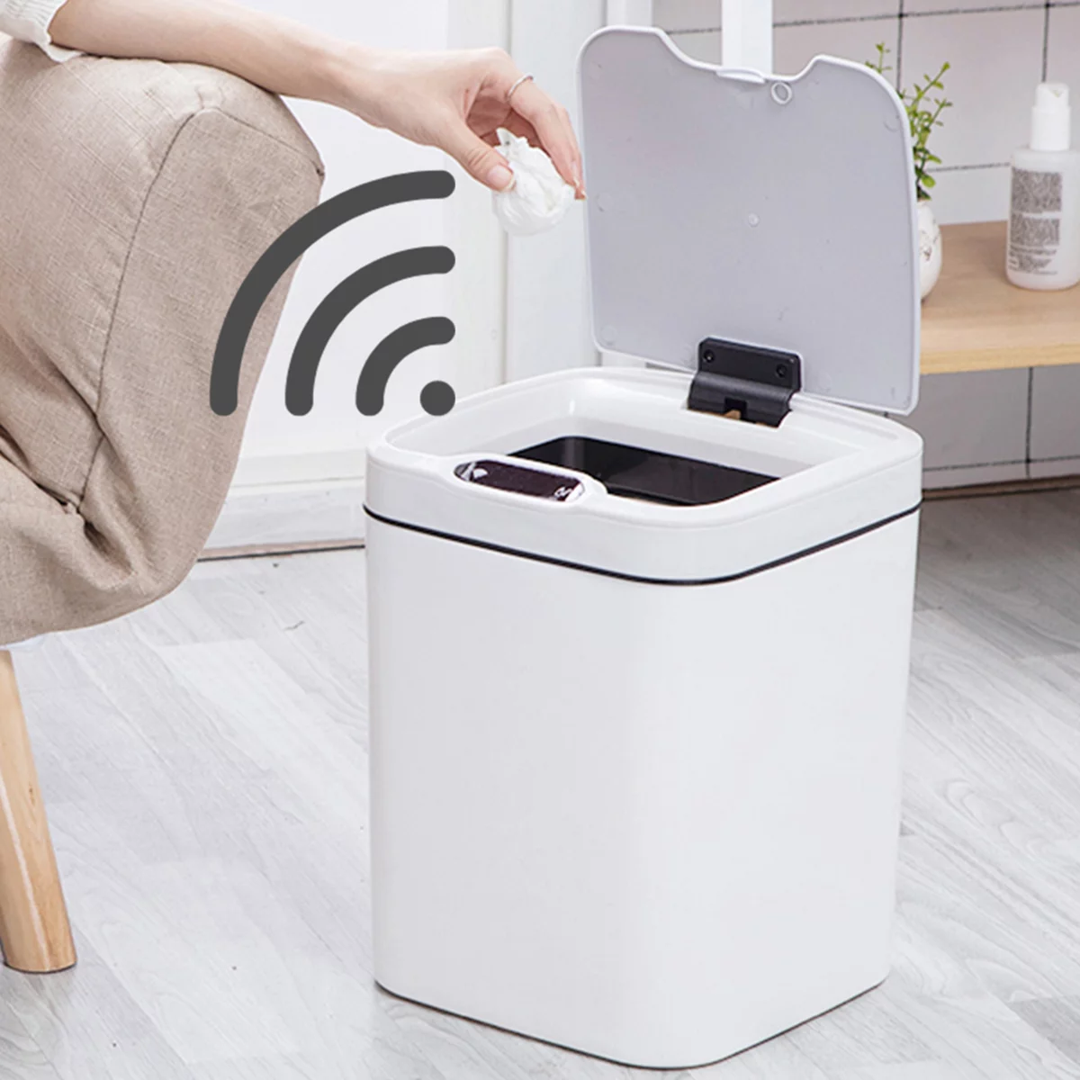
Project Sample
This Project Like A Smart Dustbin
It’s will make using Arduino

Slide 7
How to Develop
Firstly, The main item has to be purchased from a manufacturer.
Next, Electronic Devices should be found.
EX : Arduino uno board
Mini gear servo
Ultra sonic module
After, All of them get together and I can continue my project.

Slide 8
Gantt chart
Time Work piece | Week 01 | Week 02 | Week 03 | Week 04 | Week 05 | Week 06 | Week 07 | Week 08 | Week 09 | Week 10 | Week 11 | Week 12 | Week 13 | Week 14 | Week 15
Search about the project
Get some idea about project
Make Project Presentation
Give project proposal
Find material needed
Doing the project
Testing
Looking for problems
Problem solving
Get final project
Presenting the project

Slide 9
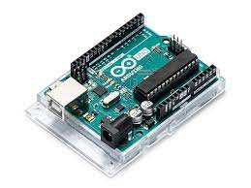

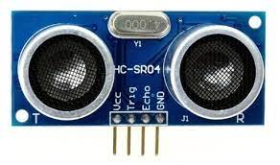
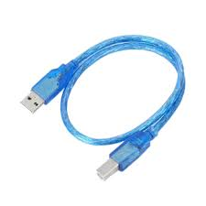
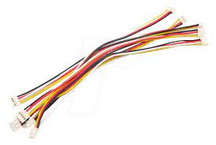
Software & Hardware
Software : Arduino software
Hardware : 1.Dustbin
2.Arduino uno R3
3.Mini gear servo
4.Ultra sonic module
5.Connecting cable
6.LED

Slide 10
Thanking You…!

